Slide 1
Artificial Intellegence
Path Planning Robot
Presented by: Instructor: Dr. Kashif
Umair Khan
Enrolled in: Artificial Intelligence

Slide 2
Objectives
Getting Familiar With The Project
Interface
Creating Obstacles
Implementing A*(Star)
A*star

Slide 3
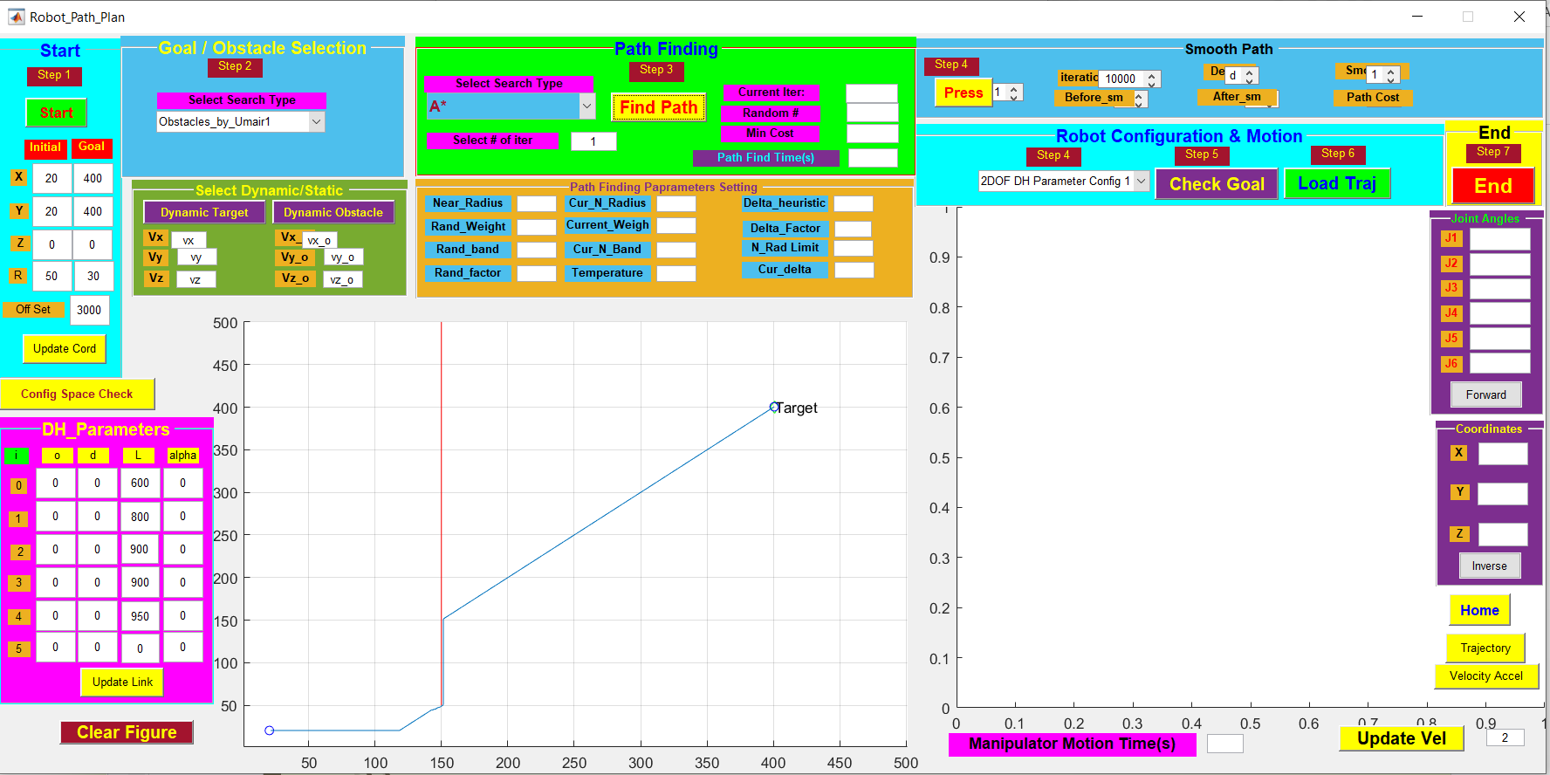
Interface & how to it works?

Slide 4
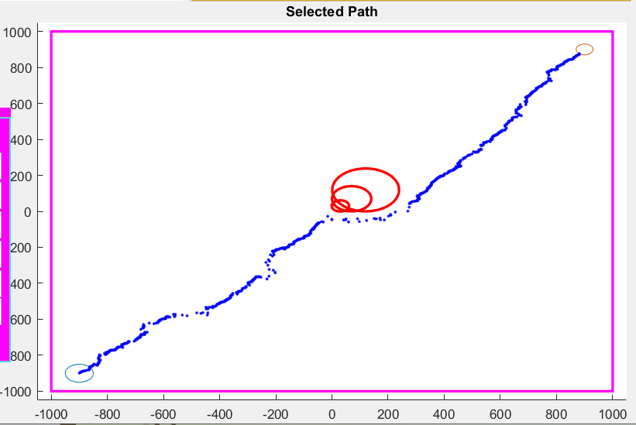
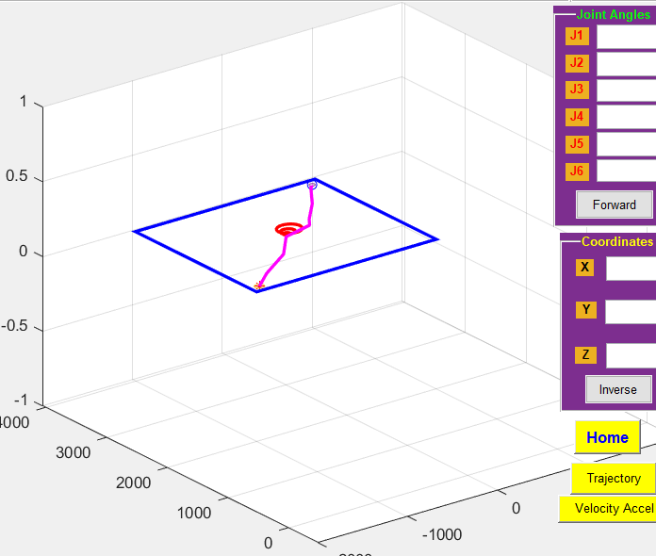
Obstacle Creation

Slide 5
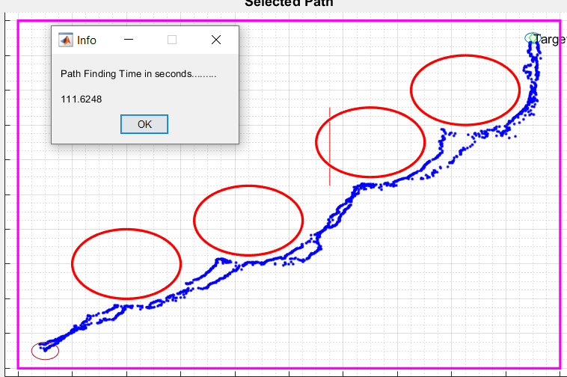
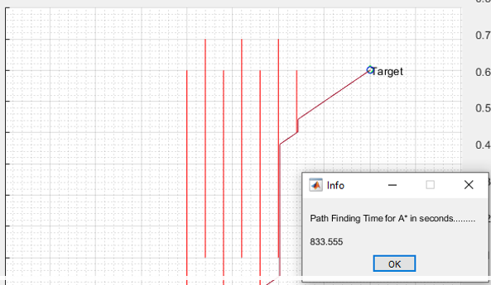
Comparison
RRT
A Star (*)

Slide 6
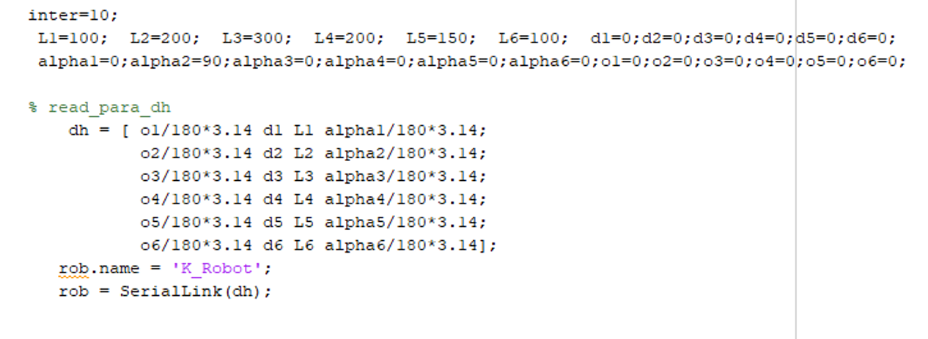

Slide 7
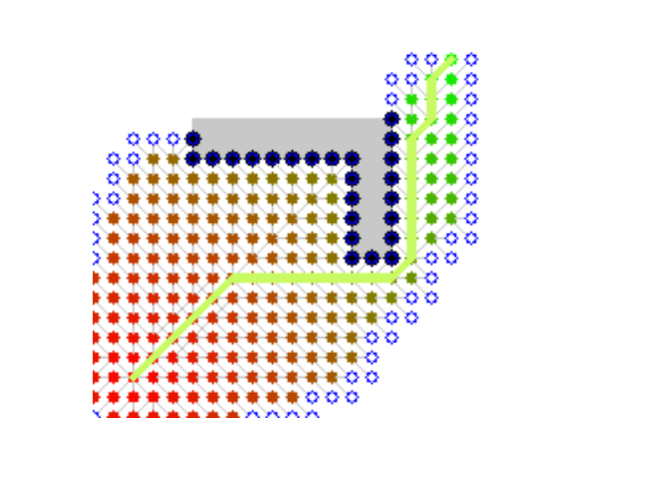
A*(Star)

Slide 8
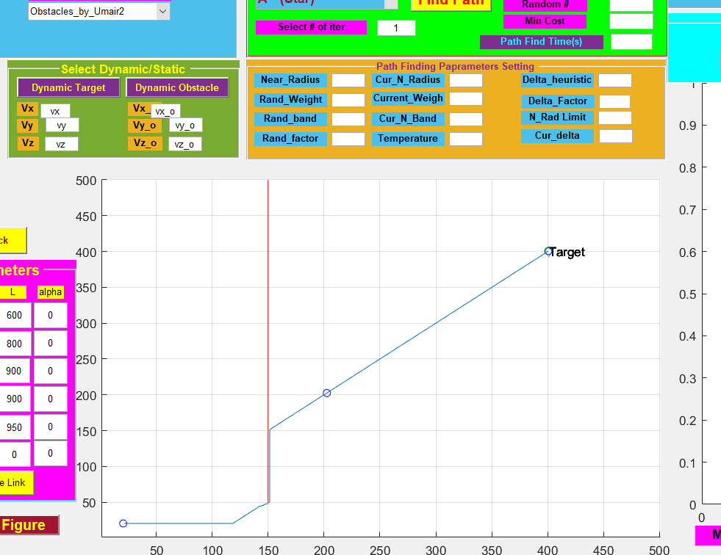
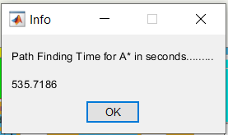
A*(Star)

Slide 9
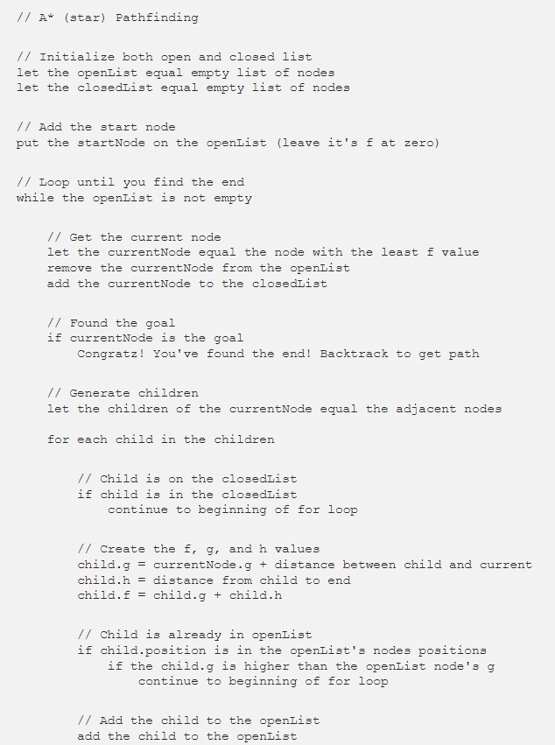
A*(Star)

Slide 10
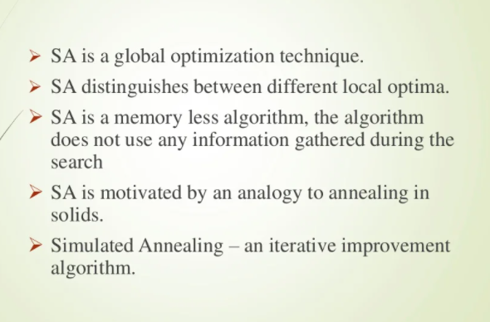
Simulated Annealing

Slide 11
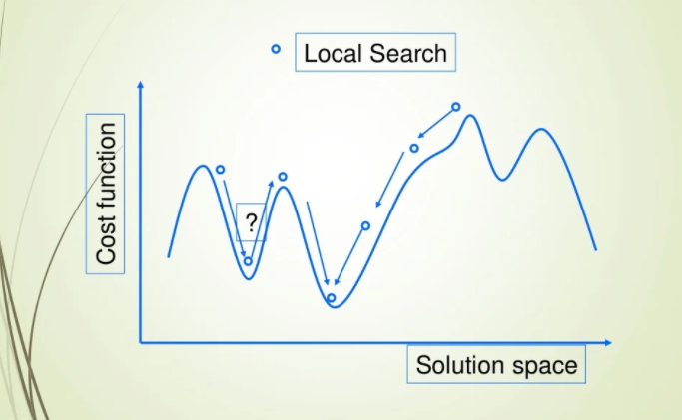
Simulated Annealing

Slide 12
Thank you

